Slide 1

CULINARYCART: AI-ENABLED BRAND PREFERENCE RECOMMENDATION ENGINE
Presented by:
BOREDDY LAVANYA [192311131]
N. BHAVYA SHREE[192572039]
M.SUNITHA[192424157]
Guided by:
DR. V. SARALA

Slide 2


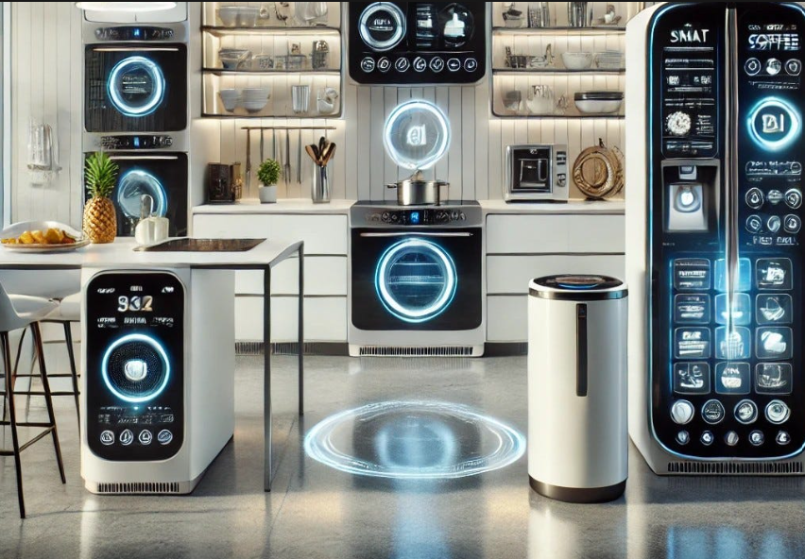
INTRODUCTION
AI-based system for recommending suitable product brands.
Helps users choose the best kitchen utensils and grocery products.
Analyzes user preferences such as budget, brand, and ratings.
Uses the Content-Based Filtering Algorithm for personalized recommendations.
Compares products based on price, quality, and features.
Saves users time by providing accurate suggestions.
Improves the online shopping experience.
Enhances customer satisfaction with smart recommendations.

Slide 3
PROBLEM STATEMENT
Difficulty in Choosing the Right Brand: Customers often find it difficult to select the best brand because many products with similar features are available in the market.
Time-Consuming Product Comparison: Manually comparing products based on price, quality, ratings, material, and features requires significant time and effort before making a purchase.
Lack of Personalized Recommendations: Most shopping platforms provide general recommendations that do not fully match a user's preferences, budget, or shopping history.
Need for an AI-Based Recommendation System: There is a need for an intelligent system that uses AI to analyze user preferences and recommend the most suitable brands, helping users make faster and more accurate purchasing decisions.

Slide 4
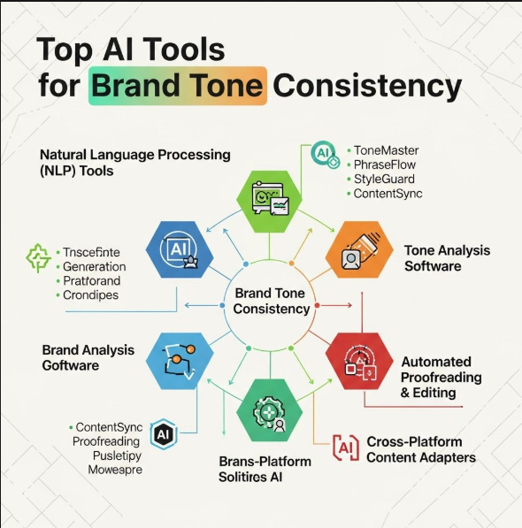
OBJECTIVES
Develop an AI-based brand recommendation system.
Provide personalized product recommendations.
Compare products based on price, quality, and ratings.
Reduce the time required to select products.
Improve the online shopping experience.
Recommend brands using the Content-Based Filtering Algorithm.
Help users make better purchasing decisions.
Increase recommendation accuracy and user satisfaction.

Slide 5


LITERATURE REVIEW
S.NO | Author & Year | Focus / Methods | Key Findings
1 | Sarwar et al. (2026) | Item-Based Collaborative Filtering | Product similarity based on user ratings helps generate relevant recommendations.
2 | Adomavicius & Tuzhilin (2026) | Hybrid & Content-Based Recommendation | Combining recommendation techniques improves personalization.
3 | He et al. (2026) | Neural Collaborative Filtering; Deep Learning | Neural networks can model complex user-item interactions and improve personalized recommendations.
4 | Koren, Bell & Volinsky (2025) | Matrix Factorization; User-Item Rating Analysis | Latent factors extracted from ratings can improve recommendation accuracy and scalability.
5 | Ricci, Rokach & Shapira (2025) | Recommender-System Algorithms; Evaluation Techniques | Recommender systems can support personalized decision-making using multiple recommendation approaches.

Slide 6
EXISTING VS PROPOSED METHOD
ASPECT | EXISTING METHOD | PROPOSED METHOD
Recommendation | Based on popularity and general ratings | Based on user preferences and product features
Brand Preference | Limited consideration of brands | Uses preferred brands for recommendations
User Grouping | No intelligent grouping | K-Means Clustering groups similar users
Product Matching | Mostly manual search | Content-Based Filtering matches products with user preferences
Personalization | General recommendations | Personalized brand and product recommendations

Slide 7
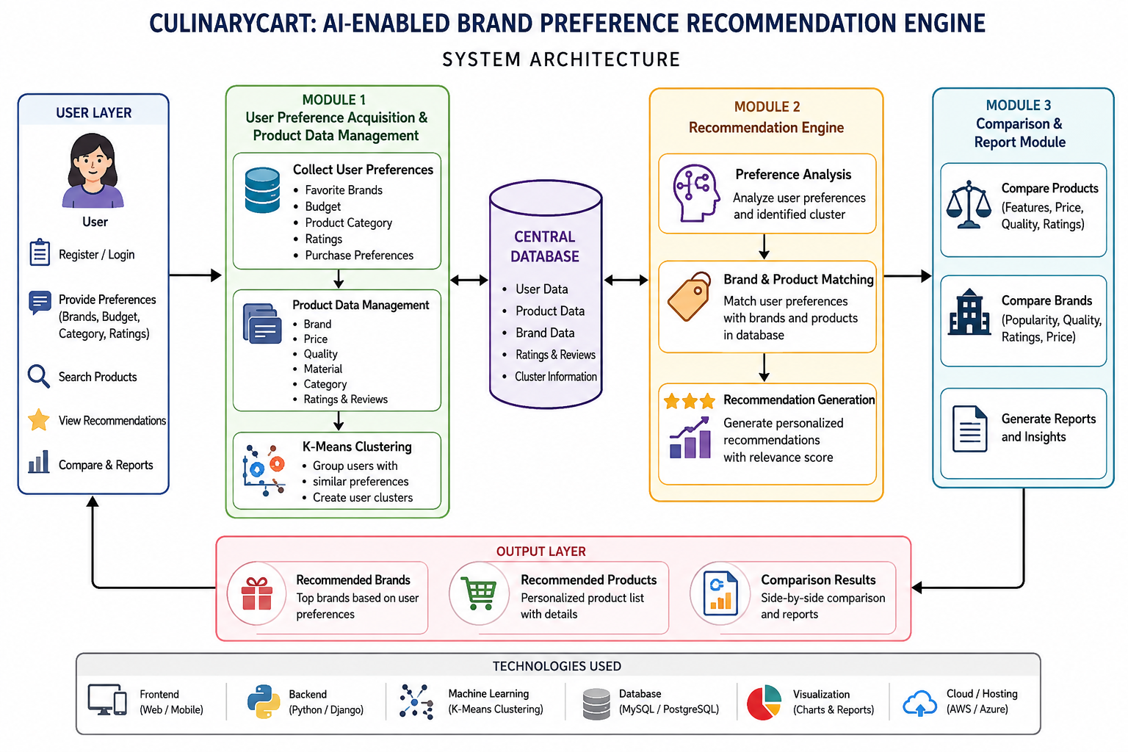
SYSTEM ARCHITECTURE

Slide 8

Module 1: User Preference Acquisition & Product Data Management Using K-Means Clustering
Collects user preferences such as favorite brands, budget, product categories, ratings, and purchase preferences.
Stores product details including brand, price, material, quality, category, and customer ratings.
Cleans and organizes the collected user and product data for further processing.
Uses K-Means Clustering to group users with similar preferences and interests.
Creates user groups such as budget-focused, premium-brand, and quality-focused users.
Uses these user groups to support personalized brand and product recommendations.

Slide 9

K-Means Clustering Algorithm Pseudo Code
BEGIN
Choose number of clusters K
Select K initial centroids randomly
REPEAT
FOR each data point
Calculate distance from each centroid
Assign data point to nearest centroid
END FOR
FOR each cluster
Calculate new centroid
END FOR
UNTIL centroids do not change
Display the final clusters
END

Slide 10
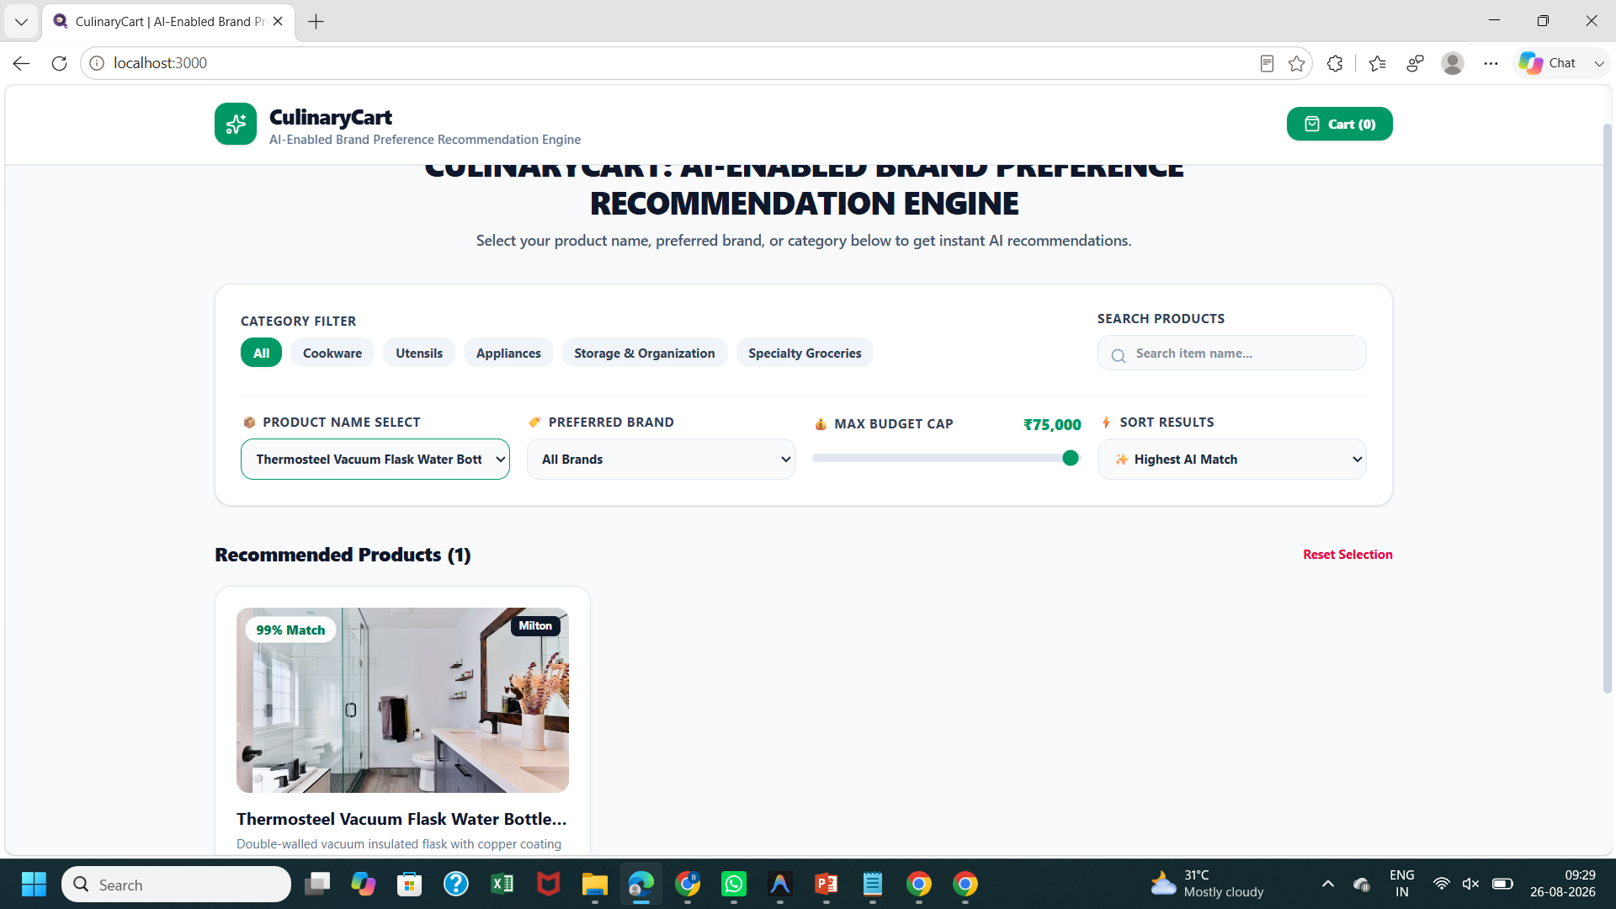
MODULE – 1 OUTPUT

Slide 11

Module 2: AI-Based Brand Preference Recommendation using Content-Based Filtering Algorithm
Uses Artificial Intelligence to analyze user preferences and generate personalized brand and product recommendations based on user requirements.
Implements the Content-Based Filtering Algorithm to compare user preferences with product features such as brand, category, price, material, quality, and ratings.
Calculates similarity scores between user interests and available products, then ranks products based on their relevance and matching values.
Provides customized brand suggestions by considering user choices, previous interactions, and preferred product characteristics.
Helps users make faster and better purchasing decisions by reducing search effort and improving recommendation accuracy.

Slide 12

Content-Based Filtering Algorithm Pseudo Code
BEGIN
Get user preferences
Get product details
Create user profile from preferences
FOR each product
Extract product features
Calculate similarity with user profile
Store similarity score
END FOR
Sort products by similarity score
Select top-ranked products
Display recommendations
END

Slide 13
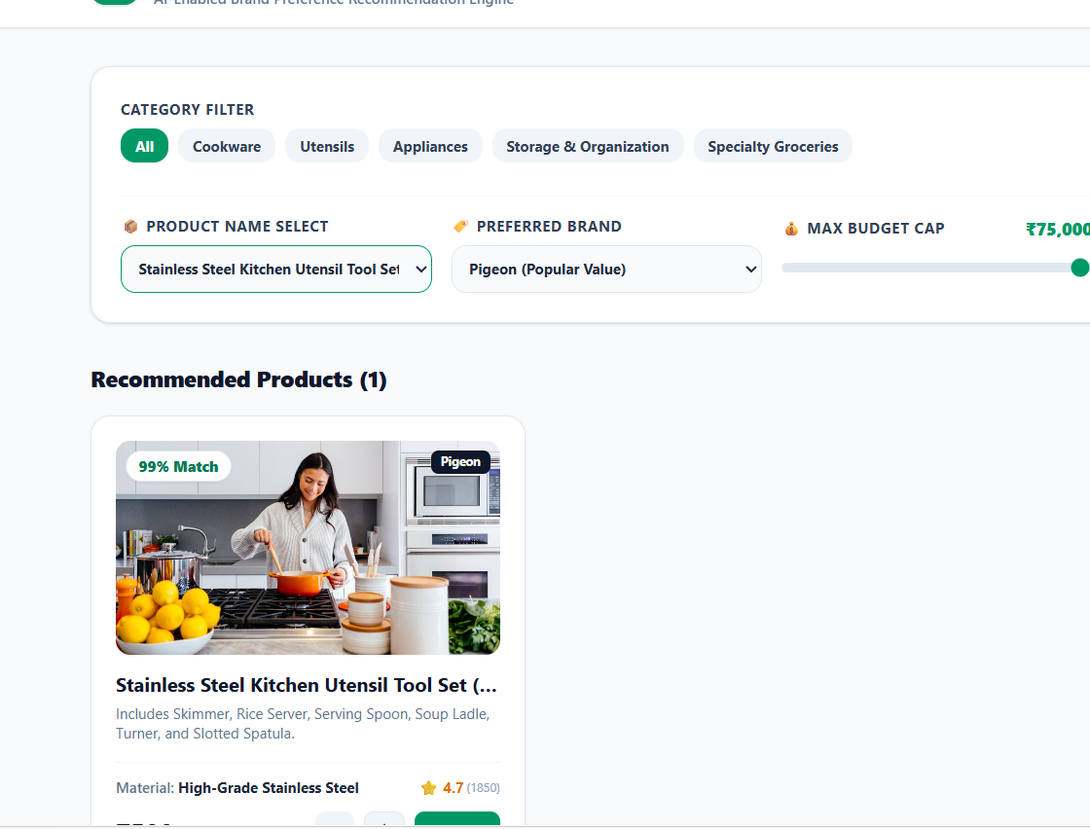
MODULE – 2 OUTPUT

Slide 14

Module 3: Product Comparison, Recommendation Report & Feedback Analysis
This module displays the recommended products and allows users to compare them based on price, quality, ratings, features, brand reputation, and availability.
It generates a detailed recommendation report that highlights the best-suited products according to user preferences and AI analysis.
The system presents comparison results in a simple and understandable format to help users make better purchasing decisions.
User feedback and reviews are collected to evaluate recommendation performance and improve future suggestions.
This module enhances user satisfaction by providing transparent comparisons, useful insights, and continuous improvement of the recommendation system.

Slide 15
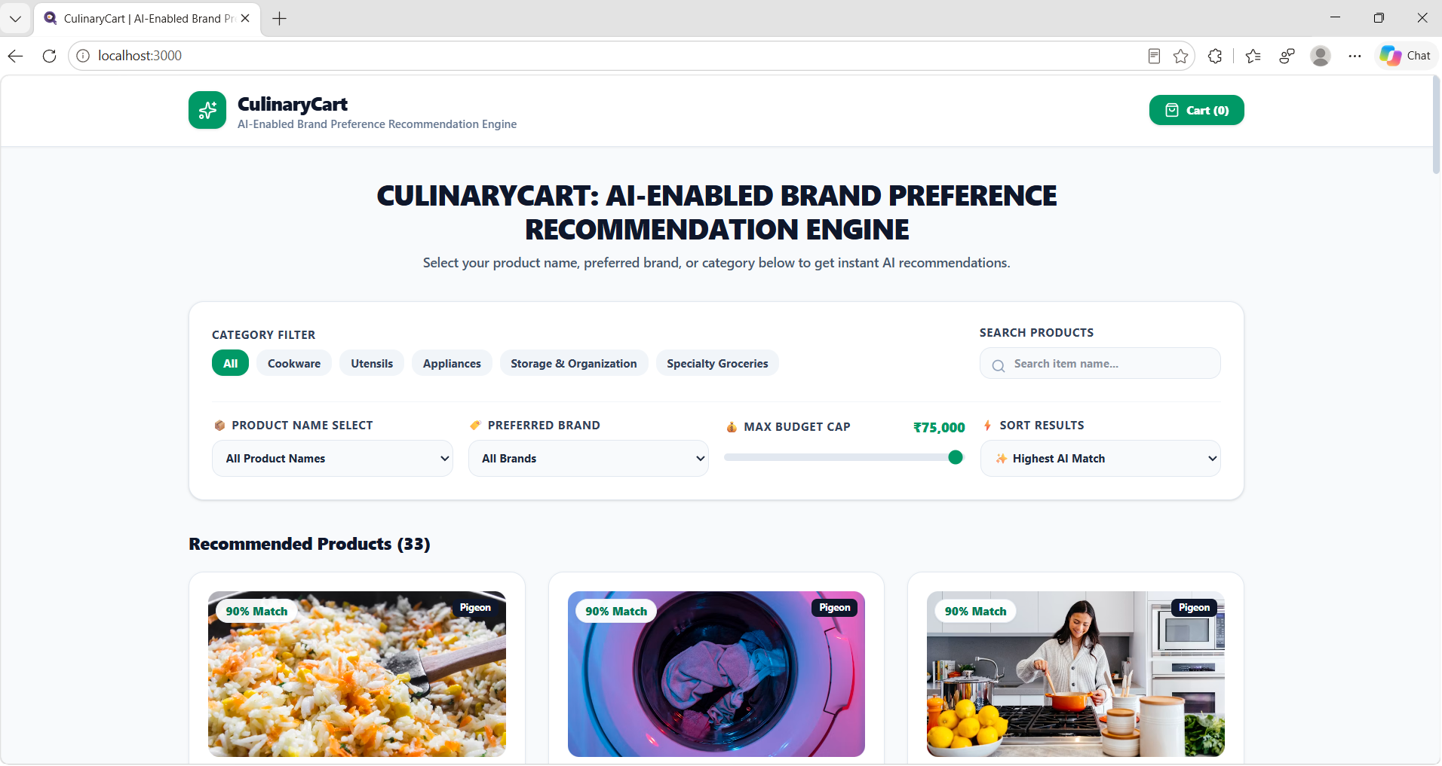
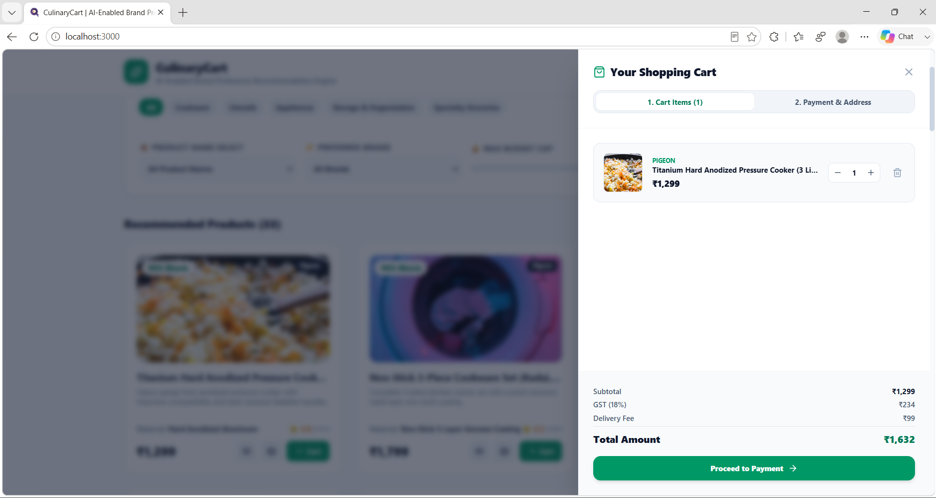
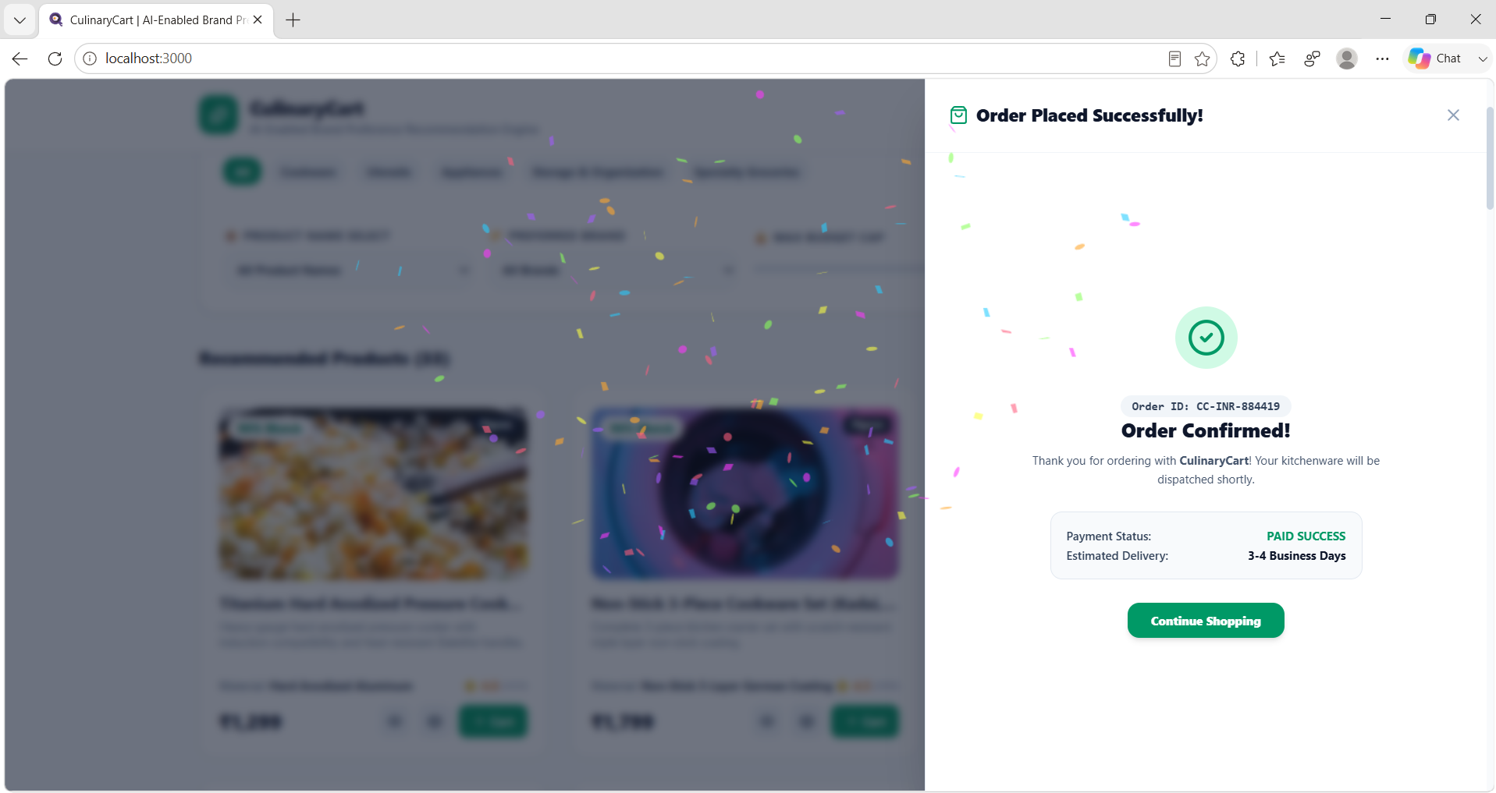
OUTPUT AND RESULTS

Slide 16

CHALLENGES & LIMITATIONS
Collecting accurate and updated product information from different brands is challenging.
Recommendation accuracy depends on the quality and availability of user preference data.
New users with limited interaction history may receive less personalized recommendations.
Changes in customer preferences and market trends require continuous model updates.
Large product datasets require efficient storage and processing techniques.
Similar product features among different brands can make accurate ranking difficult.

Slide 17
CONCLUSION
CulinaryCart successfully provides an intelligent AI-driven recommendation system that helps users select the most suitable brands and products based on their personal preferences and requirements.
The system applies the Content-Based Filtering Algorithm to analyze product attributes such as brand, price, category, ratings, and features to generate accurate and personalized recommendations.
The product comparison and feedback analysis modules improve user decision-making by providing detailed insights and continuously enhancing recommendation quality.
The proposed system reduces the time and effort involved in searching and comparing multiple products, while improving customer satisfaction and shopping efficiency.
CulinaryCart can be extended in the future by integrating advanced machine learning techniques, real-time product updates, and hybrid recommendation approaches to achieve more reliable and effective suggestions.

Slide 18

FUTURE SCOPE
The system can be enhanced by integrating advanced Machine Learning and Deep Learning techniques to improve recommendation accuracy.
Real-time product updates, price tracking, and availability monitoring can be added for better shopping assistance.
A hybrid recommendation approach combining Content-Based Filtering can provide more personalized suggestions.
Voice-based search and AI chatbot integration can be implemented to improve user interaction and convenience.
The system can be expanded to support multiple e-commerce platforms and a wider range of product categories.
Sentiment analysis of customer reviews can be used to understand user opinions and improve product recommendations.

Slide 19
REFERENCES
Aliberti, L., D’Aniello, G., & Gaeta, M., “Situation-aware Recommender Systems: A Systematic Review and Framework for Trustworthy Recommendations,” Artificial Intelligence Review, Springer, 2026.
Shojaei, A., Asadi, S., Ardakani, M. K., & Safaei, M., “LLMs Integration in Recommender Systems: A Comprehensive Survey of Frameworks, Taxonomies and Applications,” IEEE Access, 2026.
Moreno-García, M. N., & de la Prieta, F., “Deep Learning in Recommender Systems,” Future Internet, MDPI, 2026.
Raza, S., Rahman, M., Kamawal, S., et al., “A Comprehensive Review of Recommender Systems: Transitioning from Theory to Practice,” Computer Science Review, Elsevier, 2025.
Portugal, I. S., Alencar, P., & Cowan, D., “Agentic Recommender Systems: A Systematic Literature Review,” IEEE Transactions on Software Engineering, 2025.
Zhang, Y., Wang, X., & Chen, Z., “Personalized Product Recommendation Using Artificial Intelligence and Machine Learning Techniques,” International Journal of Intelligent Systems, 2024.

Slide 20
THANK YOU!

